Slide 1
Safety Presentation
Constable James Kennedy
Community Policing Section
January 14th, 2025

Slide 2
Topics
Crime Prevention Through Environmental Design (CPTED)
Parcel and Bicycle Thefts
“Make the right call”
Data Analytics

Slide 3
CPTED
Crime Prevention Through Environmental Design
3 key elements
Surveillance (Natural, Mechanical & Organized)
Access Control (Natural, Mechanical & Organized)
Territorial Reinforcement

Slide 4
CPTED - Surveillance
“Criminals do not want to be seen. Placing physical features, activities and people in ways that maximize the ability to see what is going on discourages crime.”
Natural Surveillance (Landscaping and lighting)
Mechanical Surveillance (Mirrors and cameras)
Organized Surveillance (Community and police)

Slide 5
Natural Surveillance

Slide 6
Mechanical Surveillance

Slide 7
Mechanical Surveillance

Slide 8
Organized surveillance
Resident Patrol
Neighbourhood Watch
Security Patrols
Police Patrols

Slide 9
CPTED – Access control
Target Hardening
The idea is to increase the perceived risk of crime to the potential offenders by restricting or denying access to possible crime targets.

Slide 10
CPTED – Access control
“Properly located entrances, exits, fencing, landscaping and lighting can direct both foot and automobile traffic in ways that discourage crime.”
Natural / Environmental Access Control
Mechanical Access Control
Organized Access Control

Slide 11
Natural / Environmental Access Control

Slide 12
Mechanical Access Control

Slide 13
Organized Access Control

Slide 14
Territorial Reinforcement
People protect territory that they feel is their own and have a certain respect for the territory of others. Fences, pavement treatments, art, signs, good maintenance and landscaping are some physical ways to express ownership.
Maintenance
Defensible Space

Slide 15
Territorial Reinforcement

Slide 16
CPTED
Request a free Crime Prevention Through Environmental Design (CPTED) audit by contacting our CPTED coordinator
Constable Matt Hunt (HuntM2@ottawapolice.ca)
Contact your community officer for more information

Slide 17
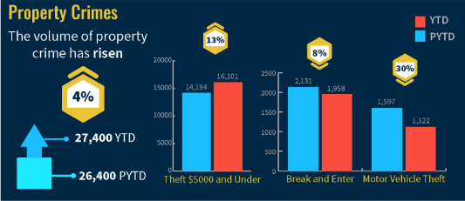
Parcel thefts
Increase in home delivery services and the use of parcels (i.e. Amazon, Shein, Temu etc.)
Holiday home deliveries average over $250 per household
Overall Ottawa trends, a decrease in violent crimes and an increase in property crimes such as theft, mischief to property. (October 2024 year to date data)

Slide 18
Parcel thefts
Ways to mitigate parcel thefts
Use parcel tracking
Install a video doorbell
Get packages delivered to pick-up locations
Purchase a mailbox sensor or parcel box
Make it obvious someone is being recorded

Slide 19
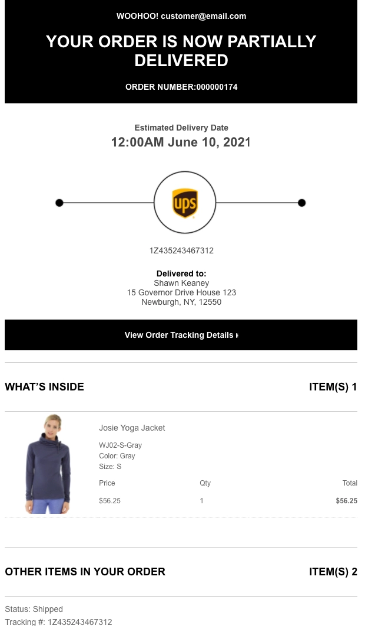
Parcel thefts
Parcel tracking
Every major parcel delivery company gives updates on when a given package will arrive.
Most will also give progress updates about where a package is in the delivery, as well as when it has been delivered to your door.
Quickly retrieve package once it has been delivered.

Slide 20
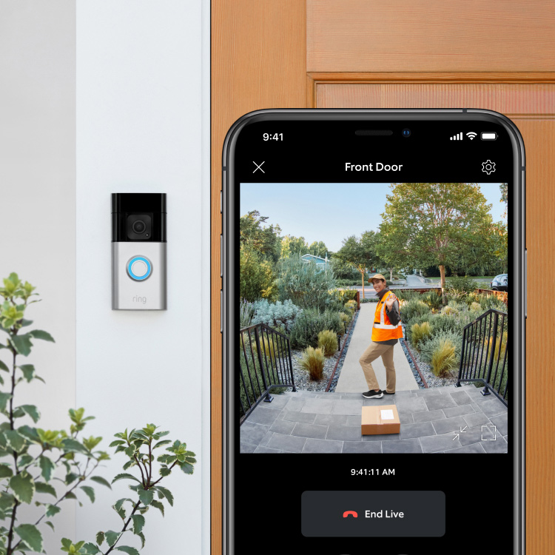
Parcel thefts
Install a video doorbell
An increasingly popular way to protect your home. Doubles as a security camera
Well known brands: Ring, Arlo, Nest or Wyze.
Can act as a deterrent.
Let's you see who is at the door through a video feed and most allow for two-way audio.

Slide 21
Parcel thefts
Get packages delivered to pick-up locations
Involves an extra trip but an option when you know you won’t be home for the parcel’s delivery.
Amazon lockers or Canada Post / Fedex / Purolator / UPS pick-up locations and hubs

Slide 22
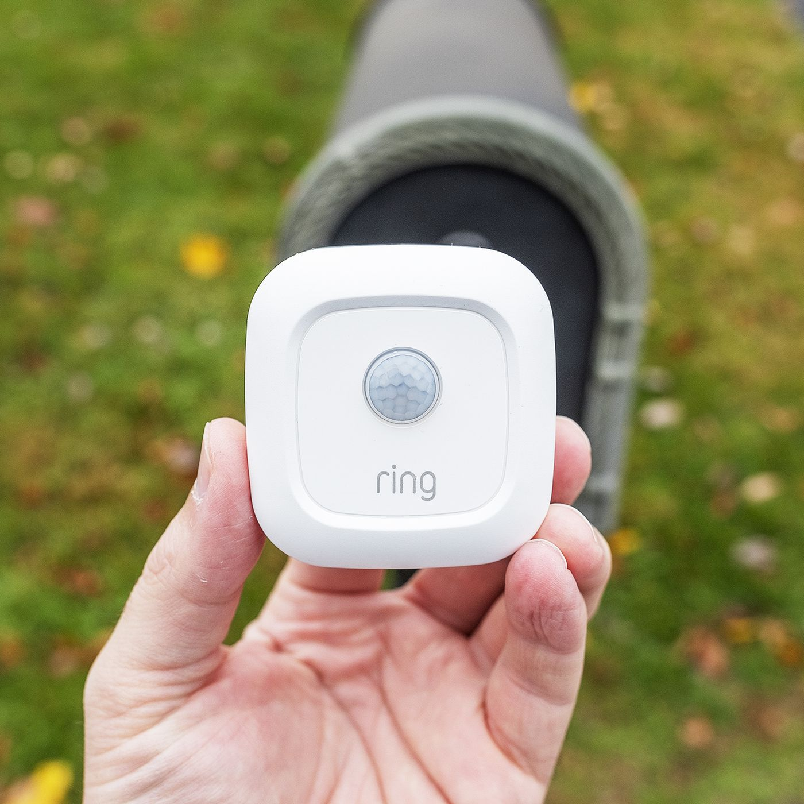
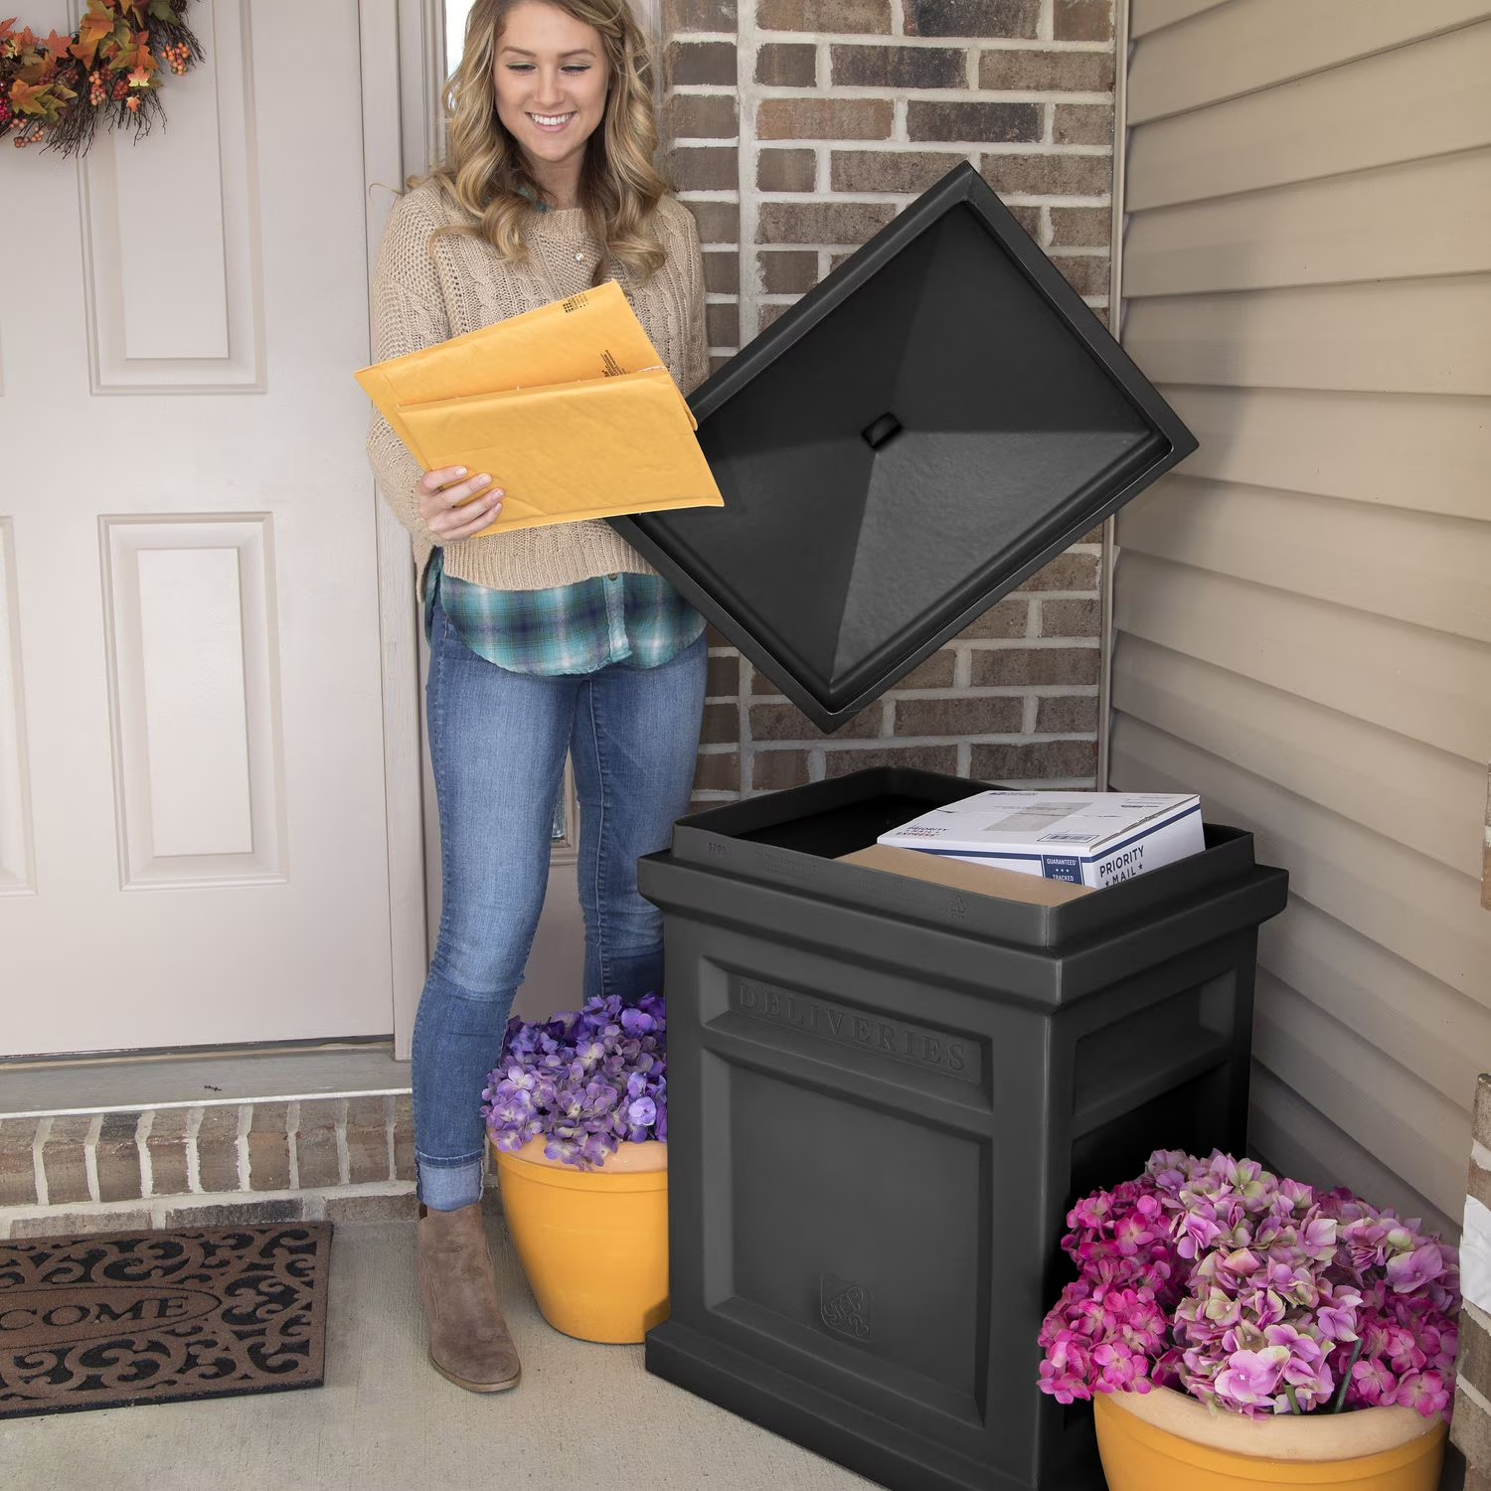
Parcel thefts
Purchase a mailbox sensor or parcel box
Notifies you when something is put in your mailbox.
Leave instructions for driver to leave parcel in box on your porch
Limits crime of opportunity

Slide 23
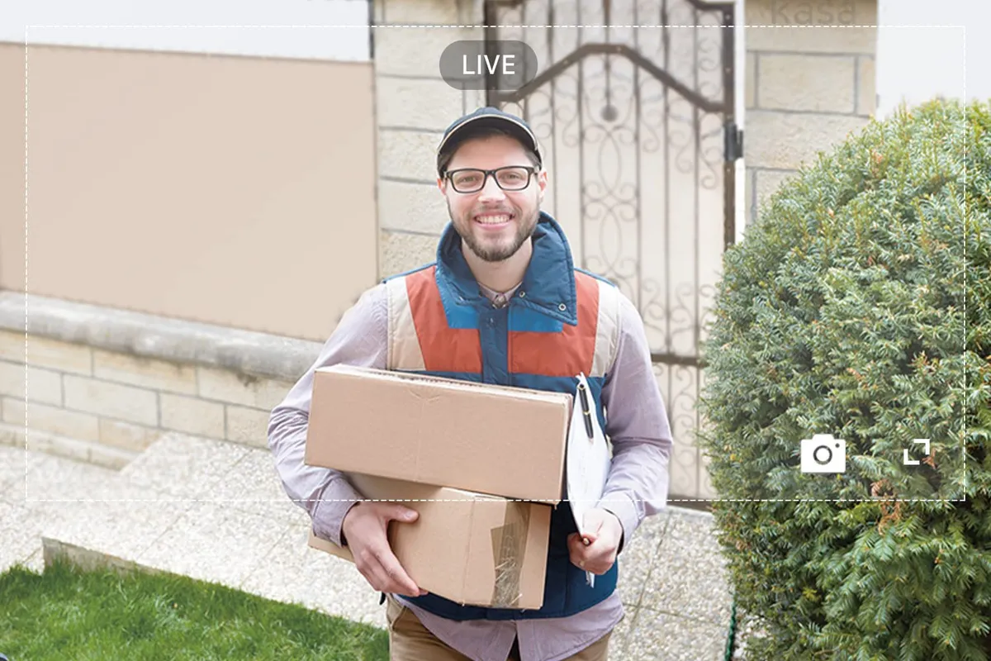
Parcel thefts
Make it obvious someone is being recorded
Your home is less likely to be subject to theft is it’s clear that you have a home security system.
Like the Video doorbell (i.e. Ring, Arlo, Nest or Wyze) effective as a deterrent for potential porch pirates.

Slide 24
Bicycle Thefts

Slide 25
Bicycle Thefts
Store your bicycle inside (in a locked garage, if available), and avoid locking your bike on the front porch or at the side of your house.
If you live in living in high-rise apartments and condominiums, store your bike in a designated secured enclosure.
Use easy-to-see bike racks, properly anchored and not concealed by landscaping or structures.
Invest in a proper bike lock, such as a U-Lock that requires more time to defeat than a cable lock. Consult with your local bike shop for expert advice and how to secure your bike properly.
Take your helmet and any bike accessories with you (if possible) to minimize being targeted.

Slide 26
Bicycle Thefts
Register your bike with 529 Garage
Visit project529.com/garage or download the App for more information.

Slide 27
Make the right call
Ottawa Police Service
9-1-1 Life-Threatening / Crime in Progress
613-236-1222 Non-emergency
Ottawapolice.ca Online reporting
City of Ottawa
3-1-1 City of Ottawa / By-Law Services
2-1-1 Community and Social Resources

Slide 28
Online reporting
Reports taken online are:
Theft (excluding theft of passports)
Lost Property (With a visible serial number or distinct marking such as a custom engraving)
Mischief/Damage to Property
Theft from Vehicle
Traffic Complaints
Drug Complaints (Using/Dealing or Selling)
Fraud Complaints
Hate Crimes
Add information to an existing report
Notes:
Google “Ottawa Police Online Reporting”

Slide 29
When calling 9-1-1, be ready to provide this information:
Police / Fire / Ambulance?
Location (clear and concise)?
Who you are?
What is happening?
Who is involved? (gender, age, full description)
Weapons?
Other relevant information (response priority, nature of threat, safety concerns)

Slide 30
Triage of calls
Life-Threatening incidents are priority 1 calls;
Crimes in progress where life is not necessarily at risk are priority 2 calls;
Other incidents, depending on various elements, will be priority 3 or priority 4 calls (the majority of calls to police).
Notes:
For P1 and P2 calls a unit will be sent asap and if no units are available, the dispatcher will broadcast over the radio to ask units to make themselves available. P3 and P4 calls will be dispatched when a unit is available and there are no P1 or P2 calls. This can sometimes take a few hours depending on call volume.

Slide 31
Report, Report, Report!!!
OPS operates under an intelligence-led policing model.
Even if only for statistical purposes, reports assist in dictating where resources should be deployed.

Slide 32
Crime intelligence analysis unit (CIAU)
15 Crime Analysts with the Ottawa Police Service
Each analyst covers a portfolio, reads the reports and calls relevant to their area of crime.
District analysts read all the calls for service in their designated geographic area and look for trends and patterns, help identify suspects, provide linkages for investigations, monitor open source social media and support patrol.

Slide 33
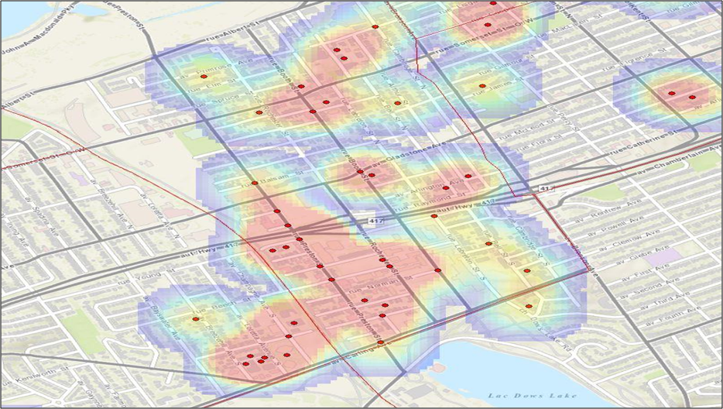
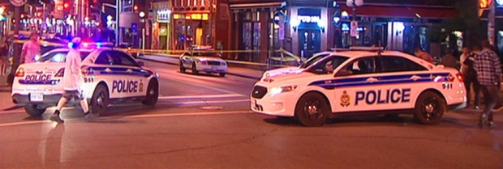
Crime intelligence analysis unit (CIAU)
Analysts play a role in police resource deployment:
Identify areas of activity by crime type
Identify problem addresses or locations
Identify persons of interest involved in certain activity
Provide actionable information directly to patrol officers
Make recommendations on areas for special attention and extra patrols

Slide 34
Community safety data portal
data.ottawapolice.ca
Crime map
Overdose calls
Hate Crime Data

Slide 35
Questions?

